Slide 1
Analysis of World Bank IBRD Loans

Slide 2
Let’s Discuss the Underlying Problem
The International Bank for Reconstruction and Development (IBRD) is the world's largest development cooperative working with the World Bank. They provide monetary support and also finance loans to member countries of UN. Most of these loans were disbursed and repaid, however, some of them were cancelled.
The loan cancellation is a loan that was ready to begin but withdrawn before disbursement or a disbursing loan getting cancelled midway.
Due to the scale of loan amounts and the processes behind them, cancellations cause a tremendous waste of time as well as financial cost.
In order to prevent this, the project focuses on analysing cancelled loans and finding insights to prevent or prepare for such loans.
As Big Data Engineers, our aim is to deal with a large amount of data from different data sources and process them for further understanding and visualisation.

Slide 3
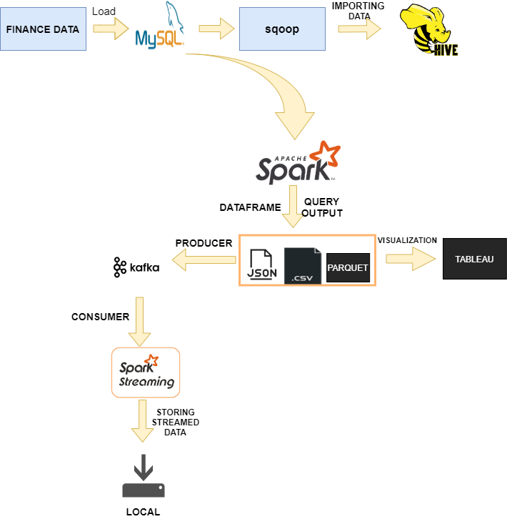
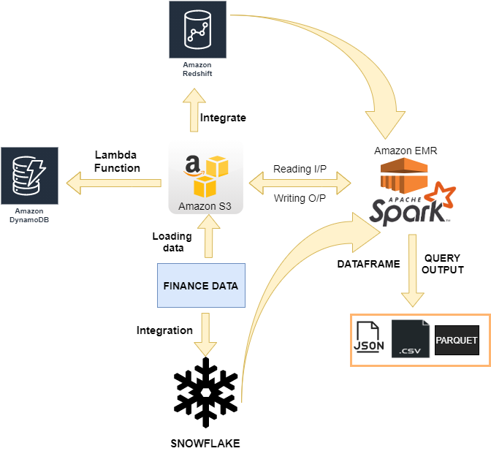
Architecture

Slide 4
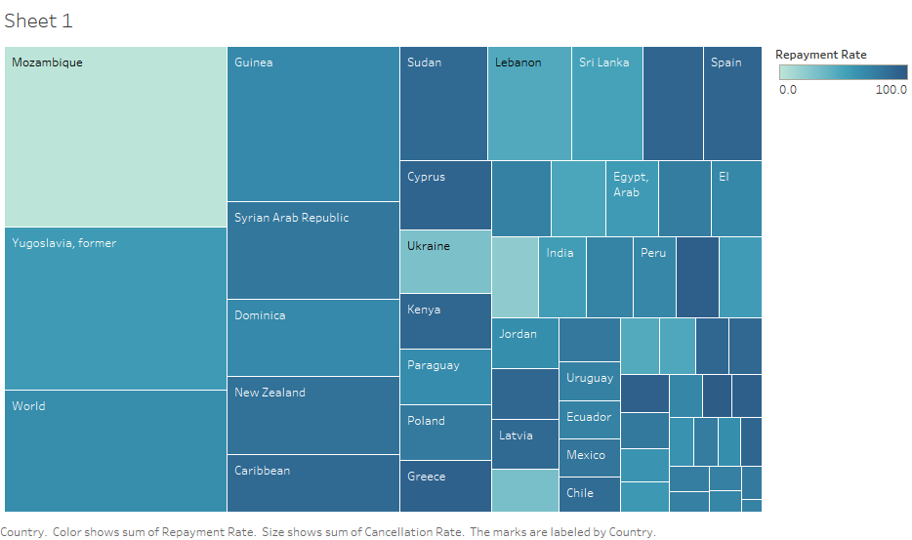
Understanding Data
Q1. Which are the countries with highest total loans with their repayment rate, and cancellation rate?
The repayment rate of Mozambique is 0%. And there cancellation rate is 50%.

Slide 5
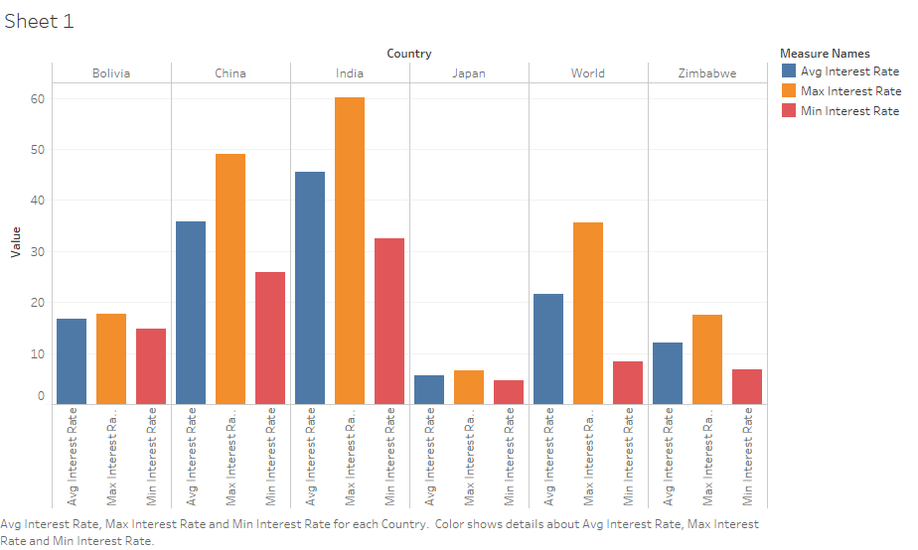
Understanding Data
Q2. Finding the maximum, minimum and average interest rate based on the loan status, loan type, for countries of High GDP in comparison with countries of Low GDP:
The countries with high GDP like India and China are given loans with higher interest rates comparatively.

Slide 6
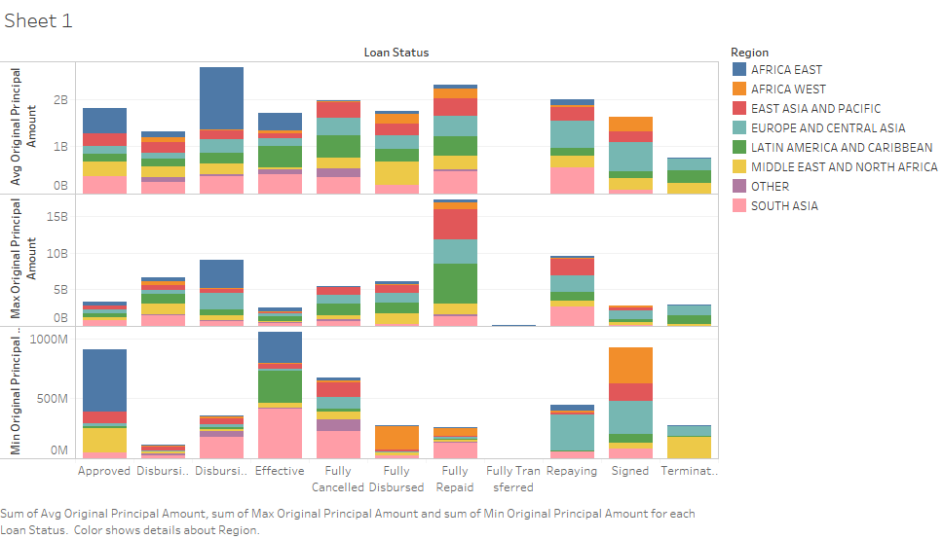
Understanding Data
Q3. Finding the maximum, minimum and average original principal amount based on the loan status, loan type and region:

Slide 7
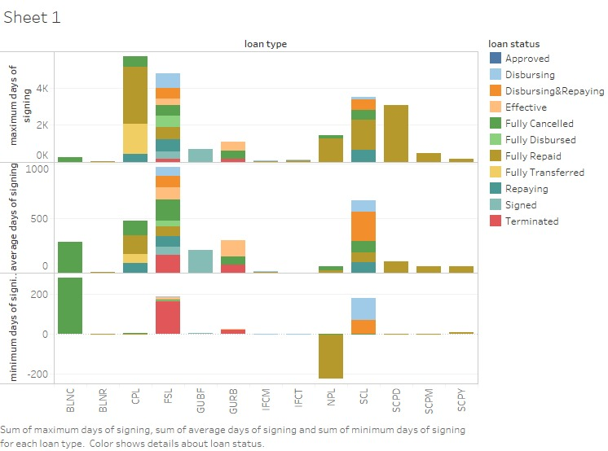
Understanding Data
Q4. Finding the relation between loan approval/ loan cancellation with respect to the difference between agreement signing date and board approval date:
A trend was observed that cancelled loans had greater difference in days overall except for some loan types.

Slide 8
Thank You.

